Slide 1

Where is a mobile map used in map-assisted pedestrian navigation?
Author: Zhengfang Xu
Supervisor: Prof. Dr. Sara Irina Fabrikant
Dr. Mona Bartling

Slide 2
Intro
RQ
Data
Method
Timeline
When using a mobile map to navigate to a new place, where do you need to unlock the phone screen and check the map?

Slide 3

Intro
RQ
Data
Method
Timeline
To understand where people check the map, we need to know why people check the map.
Related research: motivations behind checking map
Wayfinding behavioral actions are those linked to
orientation,
route decision,
route monitoring,
destination recognition
(Carpman & Grant, 2002)

Slide 4

Intro
RQ
Data
Method
Timeline
Checking map assists people in making decision during navigation.
Related research: decision making during navigation
Pedestrians tend to make decisions before reaching intersections.
People with higher spatial ability, earlier to make decisions.
(Brunyé et al., 2018)

Slide 5




Intro
RQ
Data
Method
Timeline
Map use strategies help us understand where people check map.
Related research: types of map use strategies during navigation
constant
support
independent and attentive
least effort and inattentive
(Webber et al., 2012)

Slide 6
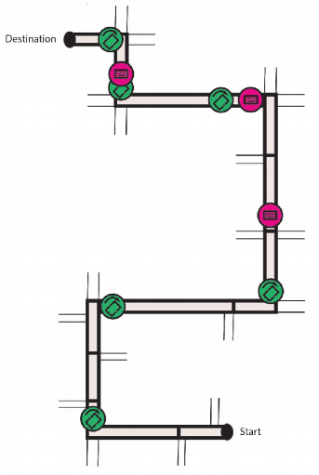
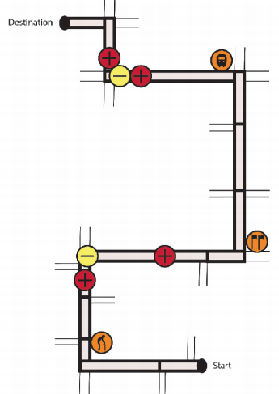
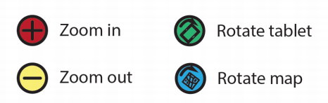
Intro
RQ
Data
Method
Timeline
Map use strategies help us understand where people check map.
Related research: types of map use strategies during navigation
Taking specific map interaction types into consideration.
(Brügger, 2020)

Slide 7
Intro
RQ
Data
Method
Timeline
Research Gap:
Little research has explored how people's map-checking behaviors change when the route varies (e.g., length, number of turns, whether shortcuts are used, etc.).
Little research has explored how environmental changes such as traffic density affect people's map-checking behavior.

Slide 8
Intro
RQ
Data
Method
Timeline
Research Question:
1. What are the trajectory factors (e.g., length, number of turns, etc.) that influence where pedestrians check the mobile map during walking navigation?
2. What are the differences in map-checking behavior between heavy and light traffic density environments?

Slide 9
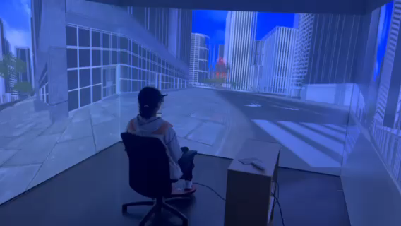
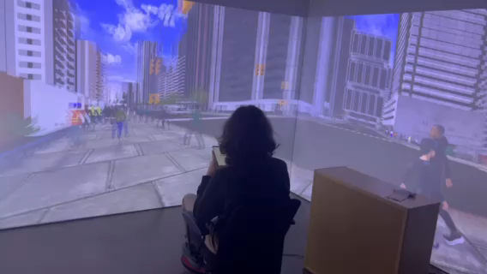
Intro
RQ
Data
Method
Timeline
Data Resource: VR Experiment
Study on mobile map assisted wayfinding
Total study participants: 54
Environmental conditions:
Light and heavy traffic density
Number of recorded wayfinding task trajectories: 863

Slide 10
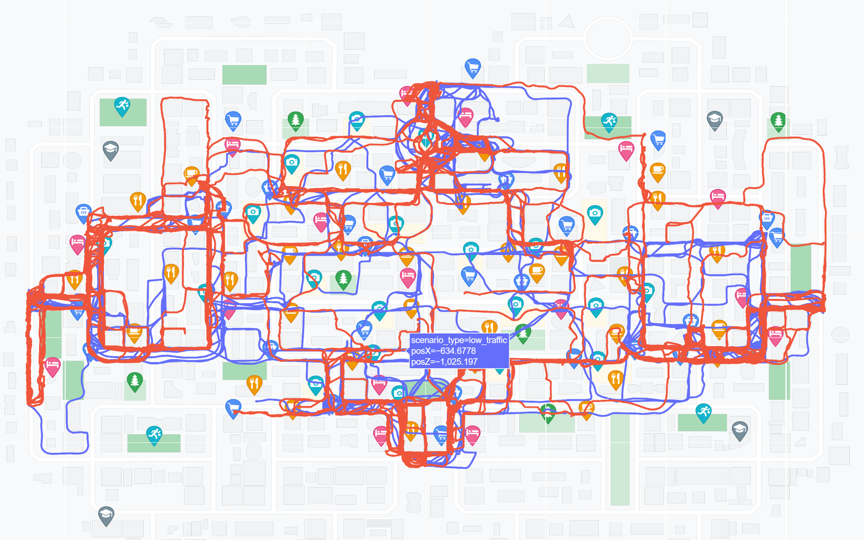
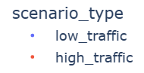
Intro
RQ
Data
Method
Timeline
Data Display:

Slide 11
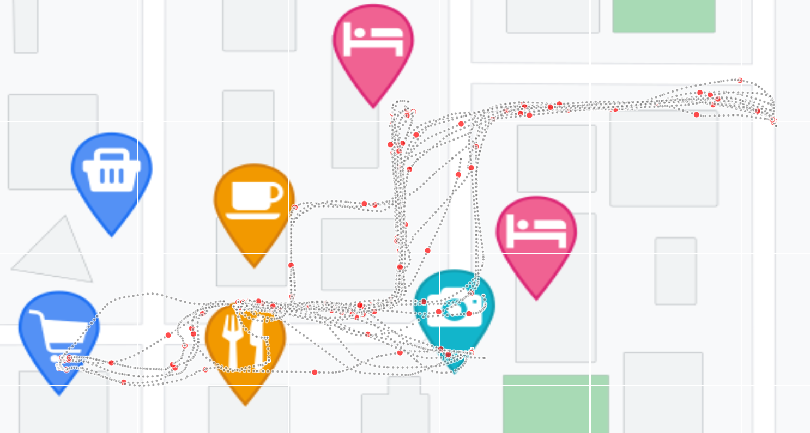
Intro
RQ
Data
Method
Timeline
Data Display:

Slide 12
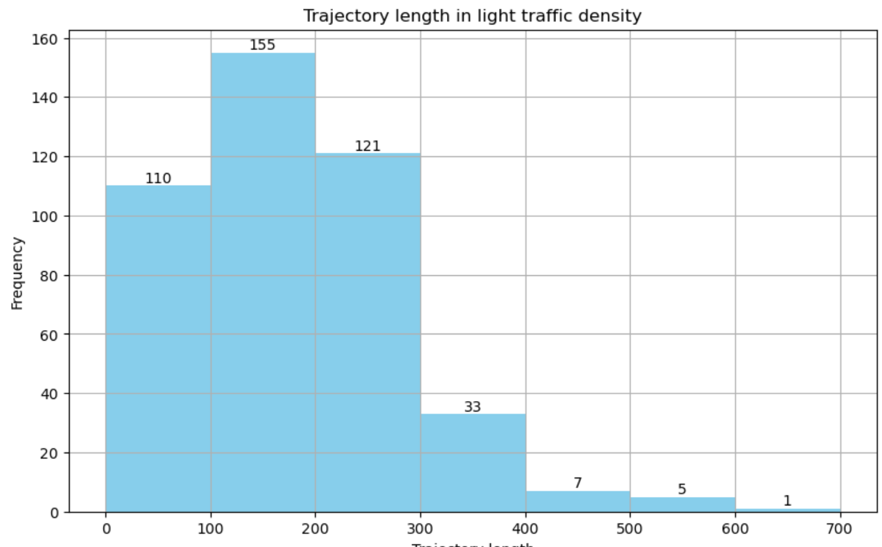
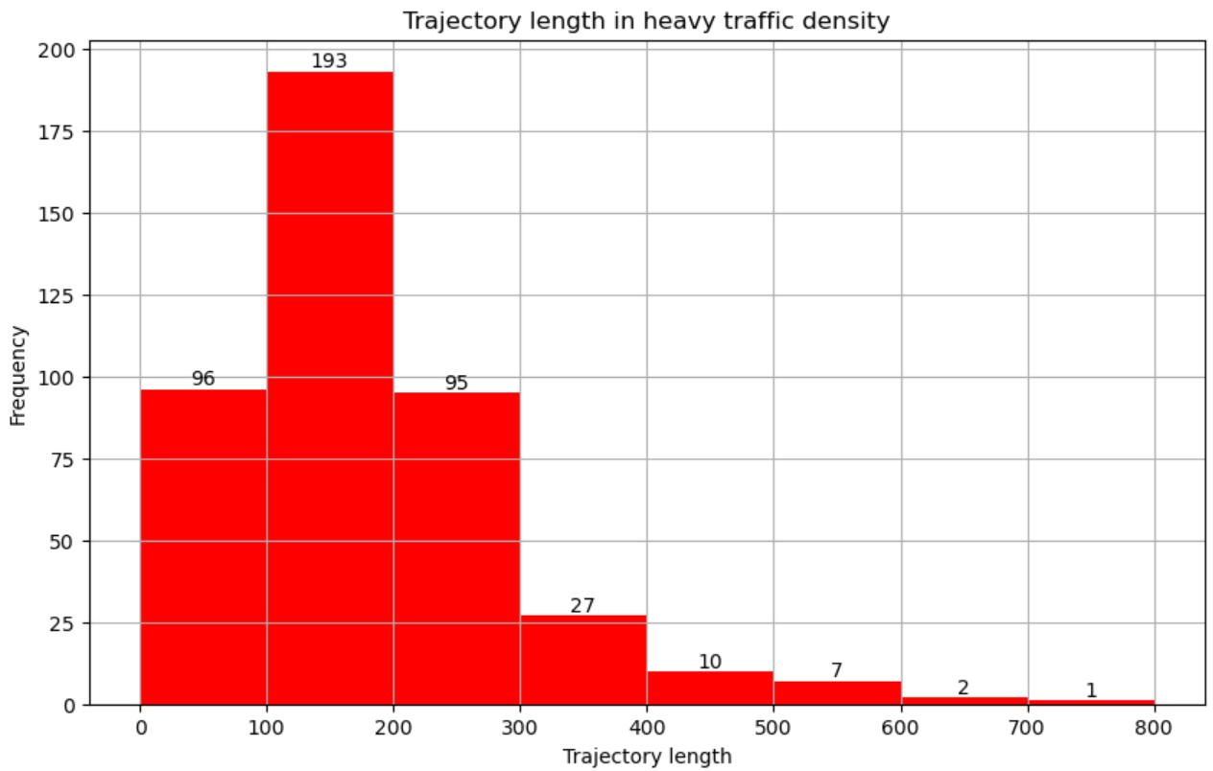
Intro
RQ
Data
Method
Timeline
Data Display:

Slide 13

Intro
RQ
Data
Method
Timeline
Method :
Choose trajectory features
E.g., length, number of turns, number of intersections, shortcut involvement, numbers of landmarks, etc.
Exploratory data analysis
To determine which features are worth further investigation and to identify any additional features that have not been discovered.
Clustering
Cluster trajectories based on the identified features.
Comparative analysis
Perform comparative analysis of map-checking behavior across trajectories with different features.
Iterative refinement
Iterate on analysis approach based on initial findings and feedback.

Slide 14
Intro
RQ
Data
Method
Timeline
1 Feb. 2024
Start of master thesis
16 Apr. 2024
Concept talk
15 May 2024
Exploratory analysis
15 June 2024
Trajectory Clustering
15 July 2024
Comparative Analysis/
Iterative Refinement
31 Aug. 2024
Thesis writing
30 Sep. 2024
Submission of the Master’s Thesis
1 Nov. 2024
Master’s Exam

Slide 15
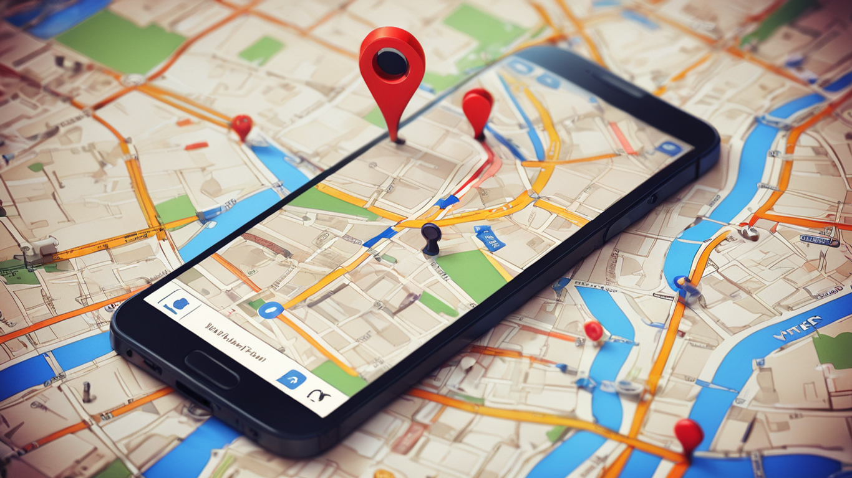
Thank you very much!

